Slide 1
CONVOLUTIONAL NEURAL NETWORKS
Presented by Robert Gale ❀ CS-559 ❀ Prof. Xubo Song

Slide 2
Convolution
Weighted moving average of an n-dimensional space
Weights = Kernel
Padding
Stride
Channels
Animation: https://towardsdatascience.com/types-of-convolutions-in-deep-learning-717013397f4d
Notes:
A little much to explain in a minute,
One way to see conv. moving weighted avg
Weights are Kernel
Animation
- input -- call it "image" - blue region
- Kernel is the shaded 3x3 region moving across the image
- The output is in green, and is that weighted average I was talking about
- Concept: padding is the border, and can make sure the output captures the edges effectively, as well helping to maintain control over the output size
- Concept: stride, which is the step size, here is 1 in both dimensions, but can be really anything. Stride
- Another concept is channels, not illustrated. When we're dealing with images we might have RGB channels, but in the middle of a conv. network, the concept of channels becomes more abstract, and really just has to do with how many kernels and parameters we want to have working

Slide 3
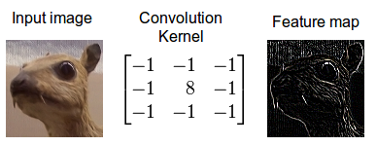
Convolution and Images, Convolution and Sound
Image: https://developer.nvidia.com/discover/convolution
Image:
https://www.dspguide.com/ch6/2.htm
Notes:
In computer vision, or even just in photoshop, convolution can be used for work like edge detection, seen on the left where it helps us recognize that this bunny thing might actually be some kind of a vampire.
Convolution can also be understood as a filtering mechanism, so in audio we can use a convolutional filter, that eliminates parts of a signal at certain frequencies.
So in that example on the right, you have an input signal that's a few periods of a sine wave combined with a ramp.
Depending on the weights you have in a one-dimensional kernel, computing that moving weighted average can leave only the low frequency ramp, or only the high freq sine wave

Slide 4
Back Propagation
http://neuralnetworksanddeeplearning.com/chap2.html
Notes:
The core of my algorithm implementation was backprop, much like others
I wanna breeze through Backprop overview
This online textbook distilled it to four equations:
Computing the error of the output layer from a cost function and the gradient of your final activation,
the error of every other layer based on values from the layer above it and the gradient of the activation
Then the real good stuff, where we use those two equations to update our bias and our weights

Slide 5
My Backprop Implementation
model = Sequential( Reshape((-1,)), Linear(784, 256), Sigmoid(), Linear(256, 10), ) cost_function = CrossEntropyLoss()
y_hat = model(batch_X)
loss = cost_function(batch_y, y_hat)
loss.backward(learn_rate=learn_rate)
class BackpropWrapper(np.ndarray):
def __init__(self, module, X, y): self.module = module self._X = X self._y = y def backward(self, dy, learn_rate):
cur_dx, cur_dw, cur_db = self.module._backward(*self._X, self._y, dy) dxs, dws, dbs = self._X.backward(dx, update, learn_rate)
dxs.append(dx) dws.append(dw) dbs.append(db) return dxs, dws, dbs
class ReLU(Function): def forward(self, X): relu = np.array(X) relu[relu < 0] = 0 return relu def _backward(self, X, y, dy): dx = np.zeros_like(y) dx[y > 0] = 1 dx = dy * dx return dx, None, None
class Linear(Function): def forward(self, X): return np.dot(X, self.weights) + self.bias def _backward(self, X, y, dy): dx = np.dot(dy, self.weights.T) dw = np.dot(X.T, dy) db = np.sum(dy, axis=(0)) return dx, dw, db
class Function(object): def __call__(self, *args): f_X = self.forward(*args) return BackpropWrapper(self, args, f_X)
class Function(object): def __init__(self): pass def __call__(self, *args): # Key point: Decorate any layer’s results with its input and output f_X = self.forward(*args)
return BackpropWrapper(self, args, f_X) def forward(self, *args): raise Exception('Must implement forward()') def _backward(self, *args): raise Exception('Must implement backward()')
Notes:
[Click twice]
I focused on trying to make my implementation very generic, where each step in the backprop has the same interface, where given input X, output y, and an error value of output y, each layer or module should return three partial derivatives: wrt x, its weights, and its bias.
[back]
Not all modules have a weight and a bias, so you can see here that ReLU returns only the partial derivative w.r.t. X
Note that I kinda split up that second equation here, treating it more like its own layer, where given this "dy" I return this part of the equation as a "dx"
[fw]
Combined with this little decorator function that I apply to every layer's forward step, this generic interface lets me step through the recursive backward stuff in a way that doesn't care what kind of layer or activation or cost we're looking at.
[fw]
And I can build a sequential network like so, and the backpropagation function lives on the output itself, which is something I had on the brain since I'd been playing with PyTorch recently, and that's how they do it

Slide 6
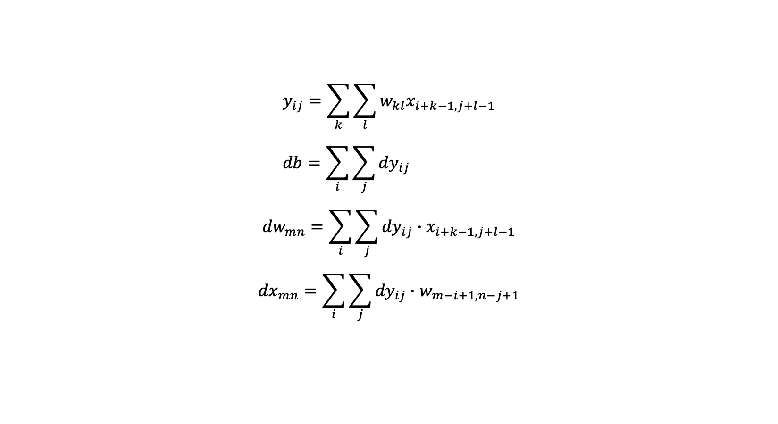
Convolution: Implementation
$$y_{ij}=\sum_{k}{\sum_{l}{w_{kl}x_{i+k−1,j+l−1}}} \\ db=\sum_{i}{\sum_{j}{{dy}_{ij}}}$$
$${dw}_{mn}=\sum_{i}{\sum_{j}{{dy}_{ij}∙x_{i+k−1,j+l−1}}}$$
$${dx}_{mn}=\sum_{i}{\sum_{j}{{dy}_{ij}∙w_{m−i+1,n−j+1}}}$$
Notes:
So given that structure, implementing the convolution layer meant:
implementing a forward pass, that first equation, which weights and sums the input values like was illustrated before.
The backward pass has those three elements, for bias, weights and an input delta
The bias gradient sums up the gradient from the successive layer
The weight gradient multiplies the output gradient by our moving X window, summed up
And the input gradient is a sum of the output gradient times each weight that touched that index on the input
Things get a little more sticky when we bring in weights and minibatches, so I'm gonna wave my hand about that and go to the next slide

Slide 7
Numerical Gradient Testing
def test_gradient_wrt_x(func, x_shape): X = np.random.normal(size=x_shape) expected = _expected_gradient(func, X) f_X = func(X) dx, dw, db = f_X.backward() np.testing.assert_almost_equal(expecte, dx[0], decimal=7)
def _expected_gradient(func, parameters, small_step=1e-4): gradient = np.zeros_like(parameters) parameters_copy = parameters.copy() for idx, x in np.ndenumerate(parameters): parameters_copy[idx] += small_step right = func(parameters_copy)
parameters_copy[idx] -= small_step left = func(parameters_copy) numerical_gradient = (right - left) / (2 * small_step) gradient[idx] = np.sum(numerical_gradient) return gradient
Notes:
I leaned on this kind of test a lot during implementation of all my layers
Basically this is a double check on all my derived gradients to make sure they align with a numerically calculated gradient, where I take a tiny step left & right for every parameter I'm checking
It saved me a bunch of times, especially as I was fiddling with the convolution layer and trying to optimize the code so numpy could do more threading

Slide 8
Experiment - MNIST
fully_connected = dnn.layers.Sequential( Flatten(), Linear(784, 256), Sigmoid(), Linear(256, 10), ) cost_function = CrossEntropyLoss() # (softmax inside here)
28 x 28 px handwritten digits
Train: 56,000, Test: 14,000
Early stopping
Minibatches: 100 per
0.0001 learn rate
Each iteration: lr *= 0.9999
2-layer fully connected baseline
vs.
CNN experiment
cnn = Sequential(
Reshape((1, 28, 28)) Convolution2d(kernel=(3, 3), in_channels=1, out_channels=16, pad='same’), ReLU(), Convolution2d(kernel=(3, 3),in_channels=16, out_channels=32), ReLU(), Flatten(), Linear(25088, 10), ) cost_function = CrossEntropyLoss () # (softmax inside here)
Notes:
Experiment!
I'm not the only one who used MNIST, but for a rapid breakdown of my setup:

Slide 9
Results
Mean classification error: Train: 0.1% Test: 2.5% Train Duration: ~10 min
Mean classification error: Train: 2.6% Test: 3.1% Train Duration: ~1 hr/epoch

Slide 10
A Deeper Look

Slide 11
Lessons Learned
Weight initialization
Overly eager with the optimizations, breaking things
I’m not gonna build a viable toolkit in a couple of weekends
memory leaks, no GPU implementation, etc

Slide 12
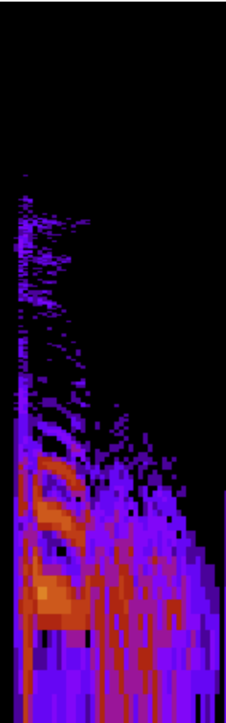
Experiment – CSLU Kids’ Speech
1019 kids, aged K-12
Each sample is a single word, narrowed to words “one” through “ten”
26 filterbank features x 412 time steps
Train: 1481, Test: 363 (grouped by speaker)
30 epochs, early stopping
Minibatches: 40 per
0.0001 learn rate
Each iteration: lr *= 0.9999
“one” “two”
Notes:
My original goal was to build a word recognizer, but this whole setup runs so slowly without having any code that can leverage GPUs
But I have some partial results so I thought I could talk about it briefly

